Slide 3
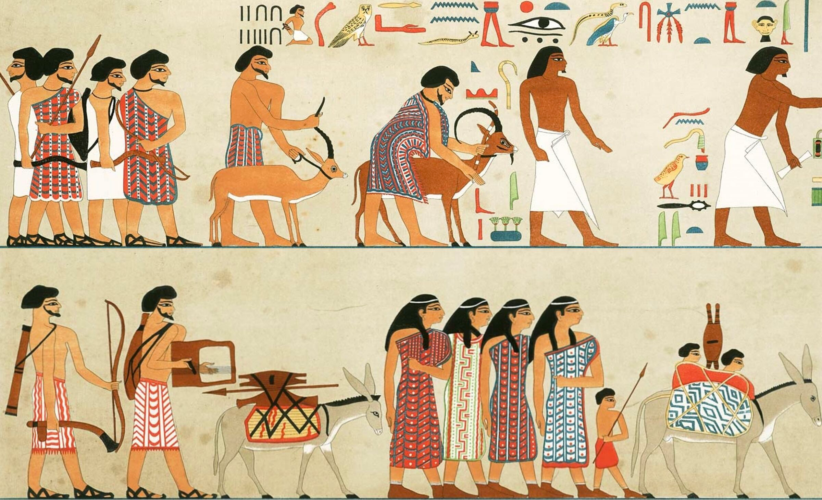

Slide 4
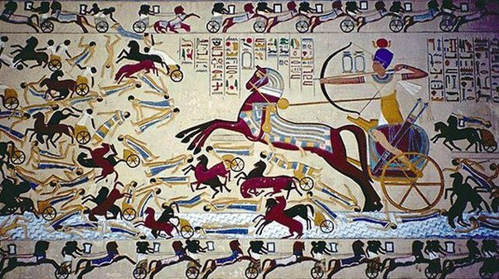

Slide 5
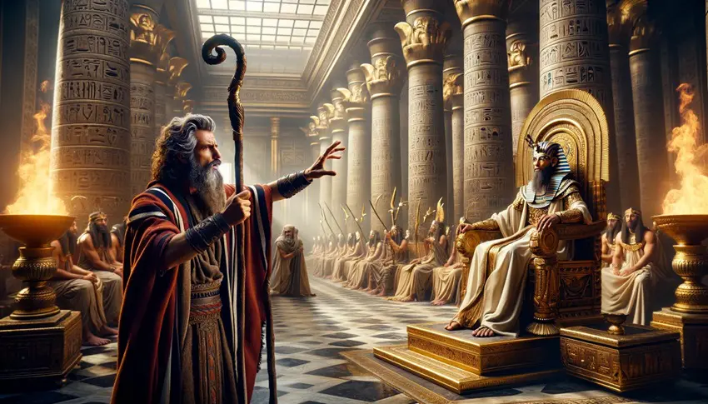

Slide 6
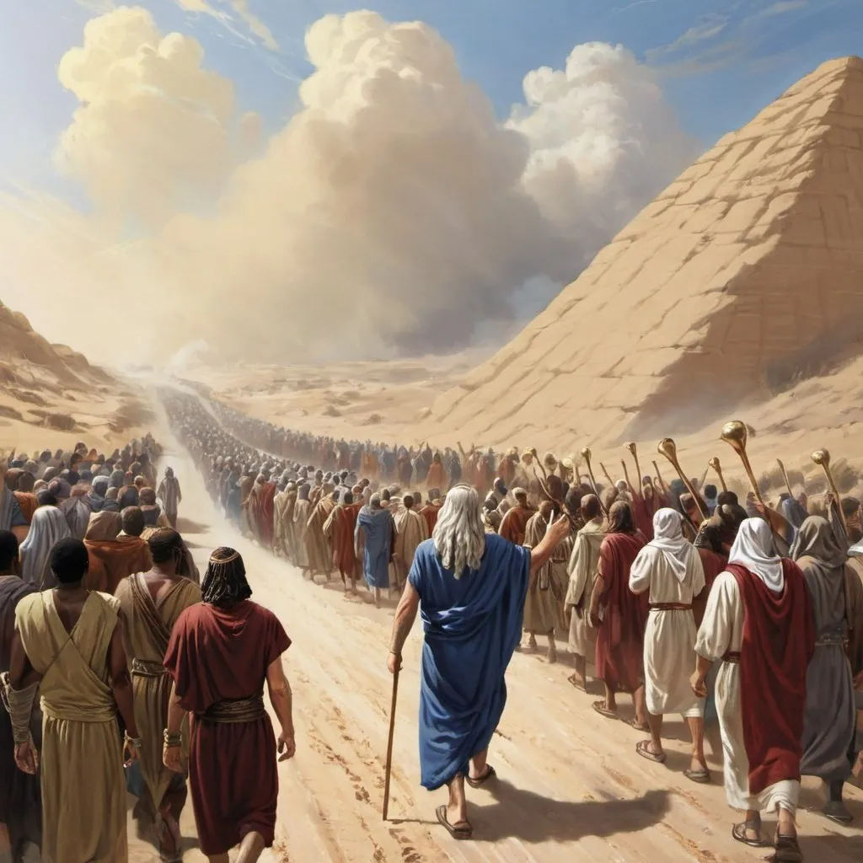

Slide 7
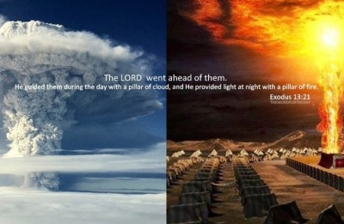

Slide 8
The pillar
The Nature Of The Cloud
  Exodus 19:11,16 “a thick cloud on the mountain”
  Exodus 40:34,35 “Moses was not able to enter the tabernacle of meeting, because the cloud rested above it, and the glory of the Lord filled the tabernacle."
  Leviticus 16:2 “I will appear in the cloud above the mercy seat."
It Was A Constant And Infallible Guide
  God never left them alone

Slide 9
The pillar
It Was The Defense Of Israel
  Exodus 14:19,20 “ the pillar of cloud went from before them and stood behind them.”
  Psalm 46:7 “The Lord of hosts {is} with us; The God of Jacob {is} our refuge [defense, high fort (tower)]."
It Was The Joy And Confidence Of Israel
  What greater joy can we have than the confidence of GOD'S PRESENCE?

Slide 10
The pillar
It Was The Oracle Of Israel
  Exodus 33:9 “that the pillar of cloud descended and stood {at} the door of the tabernacle, and {the Lord} talked with Moses."
  Psalm 9:7 “He spoke to them in the cloudy pillar”
Deuteronomy 32:4 “He is the Rock”
  1 Corinthians 10:4 “they drank of that spiritual Rock that followed them, and that Rock was Christ." John 7:37; 6:49-51; 32,33,35

Slide 11
Today christ is our pillar of cloud by day, and fire by night

Slide 12
The pillar typified the true character of christ
The Symbol Of God’s Presence
  Matthew 1:23 “call His name “Immanuel," which is translated, "God with us."
  John 1:14 “glory as of the only begotten of the Father, full of grace and truth."
  Colossians 2:9 “For in Him dwells all the fullness of the Godhead bodily;"

Slide 13
The pillar typified Christ's redeeming work
PILLAR CONNECTED WITH DELIVERANCE OF ISRAEL
Matthew 1:21 “He will save His people from their sins."
Luke 19:10 “ Son of Man has come to seek and to save that which was lost."
1 Timothy 1:15 “Christ Jesus came into the world to save sinners.”
1 John 3:8 “that He might destroy the works of the devil."

Slide 14
The pillar typified Christ as light & guide of mankind
John 12:46 “I have come {as} a light into the world”
John 1:4 “In Him was life, and the life was the light of men."
John 8:12 “I am the light of the world.”
John 14:6 “I am the way, the truth, and the life.”

Slide 15
The pillar typified Christ's glorious presence with his church
He is our GUIDE
He is our PROTECTOR
He is THE GLORY OF THE CHURCH
He is the ONLY ORACLE – Matthew 17:5 "This is My beloved Son, in whom I am well pleased. Hear Him!"

Slide 16
He is our GUIDE
He is our PROTECTOR
He is THE GLORY OF THE CHURCH
He is the ONLY ORACLE – Matthew 17:5 "This is My beloved Son, in whom I am well pleased. Hear Him!“
Hebrews 1:1,2 “in these last days spoken to us by {His} Son”
Matthew 28:18-20 “All authority has been given to Me in heaven and on earth.”

Slide 17
Will we give heed to the pillar which is christ today?
OR FALL BECAUSE OF “UNBELIEF” AS ISRAEL DID IN THE WILDERNESS?
Hebrews 3:7-13 “… Beware, brethren, lest there be in any of you an evil heart of unbelief in departing from the living God; 13 but exhort one another daily, while it is called "Today," lest any of you be hardened through the deceitfulness of sin.”

